Slide 1

Building a Compiler for a Functional Programming Language
This presentation delves into the intricate process of creating a compiler specifically tailored for a functional programming language. We will explore the fundamental concepts, stages involved, and essential optimization techniques.

Slide 2

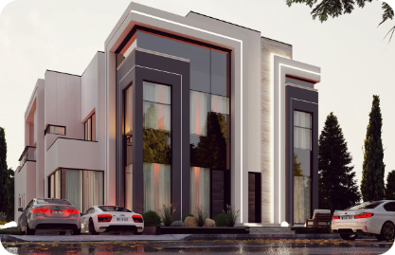
Functional Programming Language Concepts
1
Immutability
2
Higher-Order Functions
Data structures remain unchanged after creation, preventing unintended side effects and simplifying reasoning about program behavior.
Functions can be passed as arguments to other functions or returned as results, enabling code reuse and abstraction.
3
Recursion
4
Lazy Evaluation
Functions call themselves, allowing for elegant solutions to problems that involve repetitive operations.
Expressions are evaluated only when their results are needed, improving performance and reducing memory usage.

Slide 3
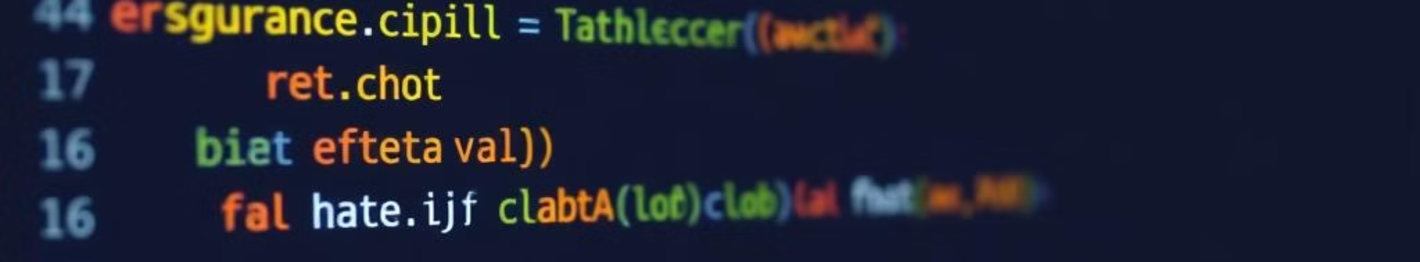
Lexical Analysis and Tokenization
1
2
3
Character Stream
Token Recognition
Token Stream
The source code is read character by character from the input file.
A lexer identifies meaningful units (tokens) within the character stream, such as keywords, identifiers, operators, and literals.
The lexer outputs a stream of tokens, representing the structure of the source code.

Slide 4




Parsing and Abstract Syntax Tree Generation
Grammar Definition
A formal grammar defines the rules for constructing valid code.
Parse Tree Construction
A parser constructs a tree structure (parse tree) that represents the hierarchical structure of the code.
Abstract Syntax Tree (AST)
The parse tree is transformed into a more abstract representation (AST) for further processing.

Slide 5
Type Checking and Inference
Type Checking
Type Inference
Type System
Ensures that operations are performed on compatible data types, preventing runtime errors.
Automatically deduces the types of variables and expressions, reducing the need for explicit type declarations.
A set of rules that define the valid types and how they can be used in the language.

Slide 6

Intermediate Representation and Code Generation
Intermediate Representation (IR)
A low-level, platform-independent representation of the code.
Code Generation
The process of translating the IR into machine code that can be executed by the target processor.

Slide 7
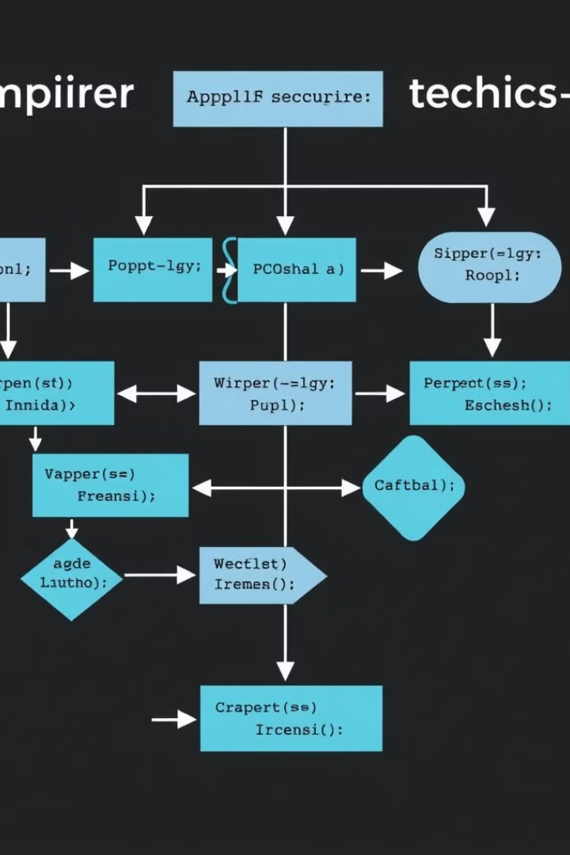




Optimization Techniques
Dead Code Elimination
Register Allocation
Removes unused or redundant code, reducing code size and improving performance.
Efficiently assigns variables to registers, minimizing memory access and speeding up execution.
Loop Optimization
Inlining
Improves the efficiency of loops by unrolling, reordering, and removing redundant computations.
Replaces function calls with their code, reducing function call overhead and improving code locality.

Slide 8
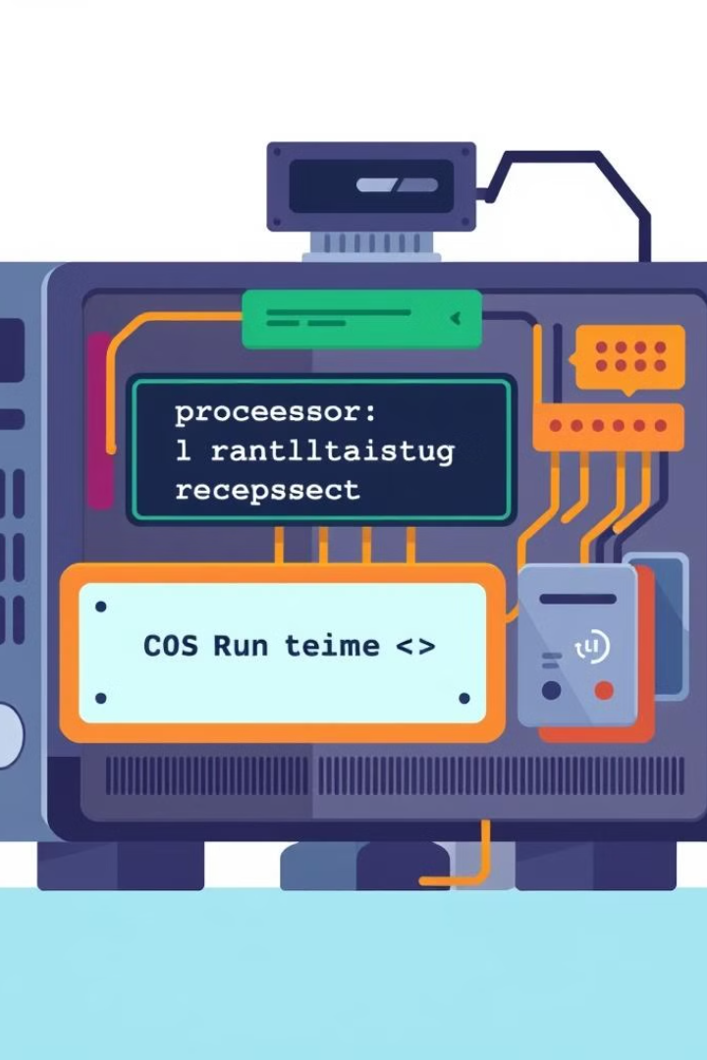
Runtime Environment and Execution
The compiled code is loaded into the runtime environment, which provides the necessary resources for execution. The runtime environment manages memory allocation, handles exceptions, and interacts with the operating system.

Slide 9
Conclusion
Building a compiler for a functional programming language is a complex and multifaceted task. It involves several stages, from lexical analysis and parsing to type checking and code generation.
Compilers are essential for translating high-level programming languages into low-level machine code that can be executed by computers. This process enables developers to write programs in a more human-readable form, while ensuring that the code is executed efficiently and correctly.

